Slide 1
ML for Sustainable Infrastructure: NBS for storm protection
2024-12-13
Notes:
30-45 mins

Slide 2
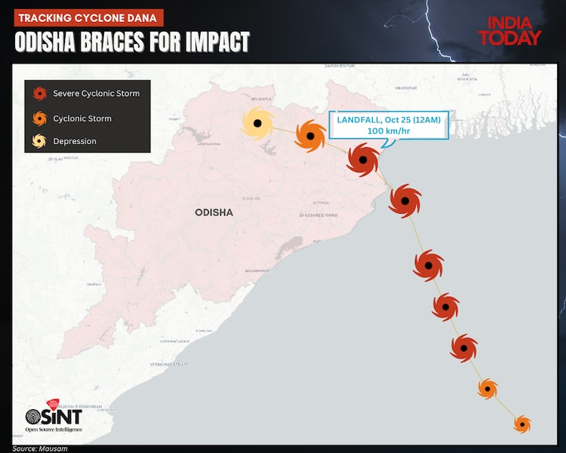
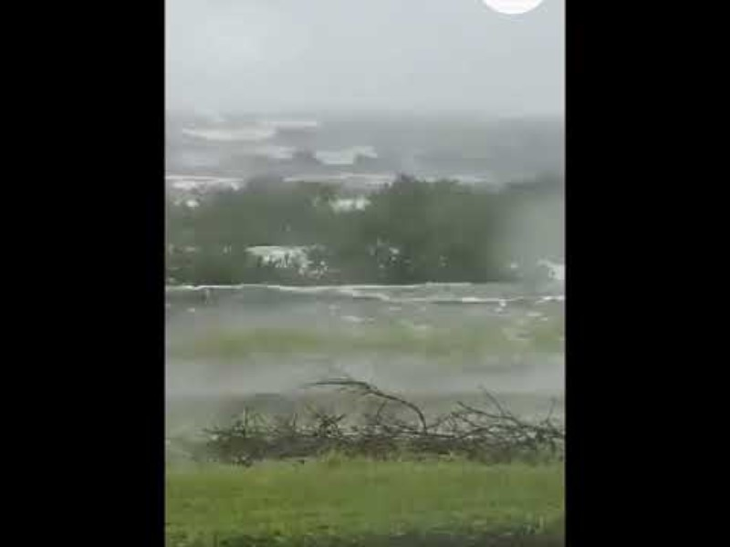
Mangroves shield Odisha coast from Cyclone Dana, 2024
Notes:
Dana at its peak intensity over the Bay of Bengal on October 24
Strongest near BhitarKanika

Slide 3
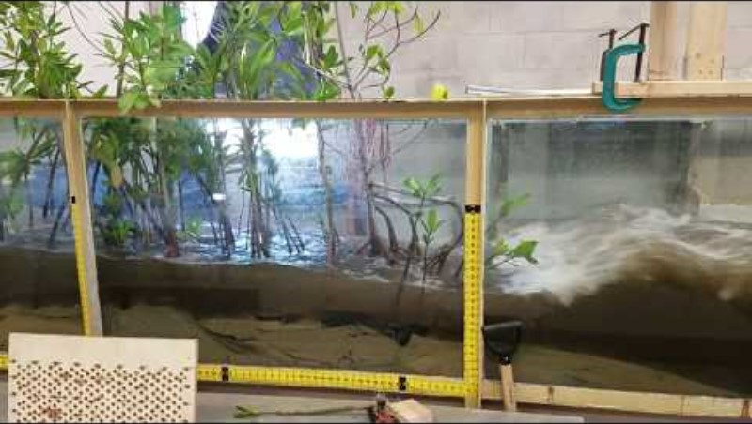
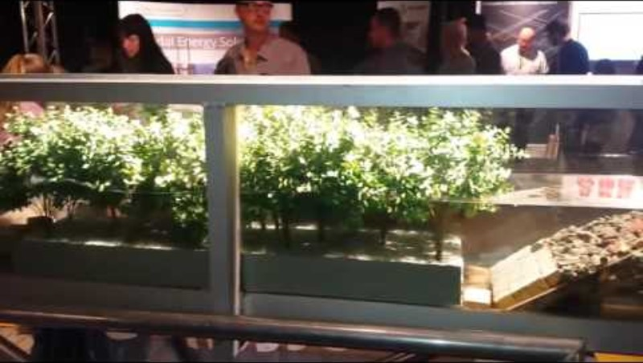
Mangroves in wave tank experiment
Notes:
Florida Institute of Technology

Slide 4
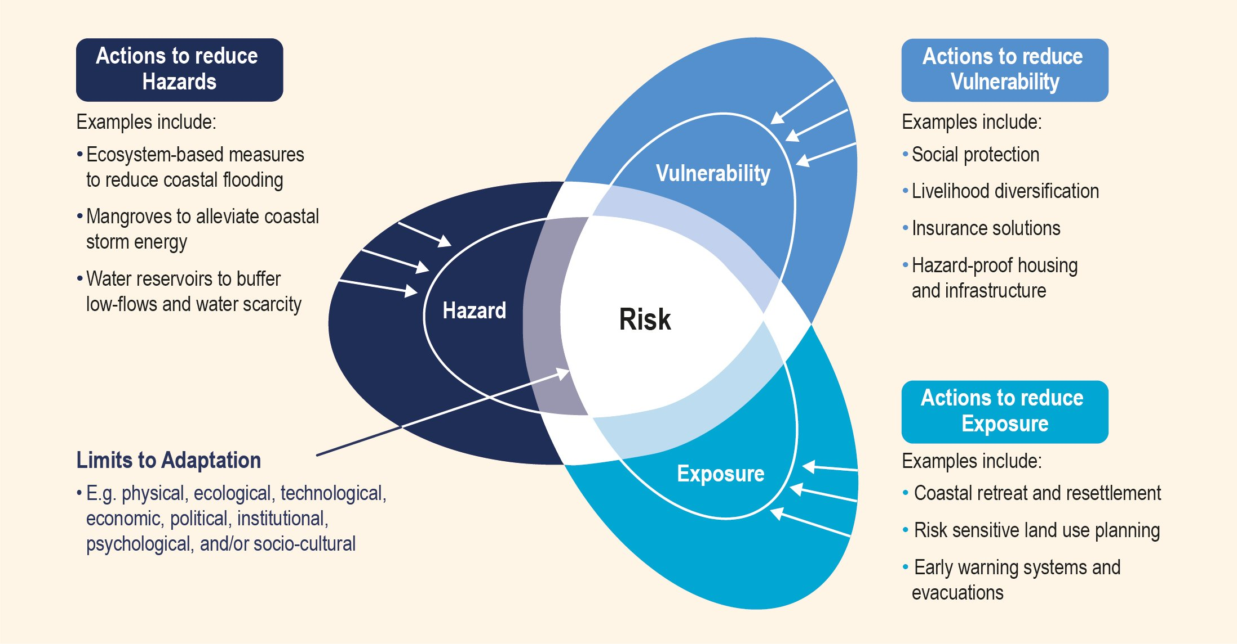
Risk framework
Notes:
https://www.ipcc.ch/site/assets/uploads/sites/3/2019/11/IPCC-SROCC-TS_4.jpg

Slide 5
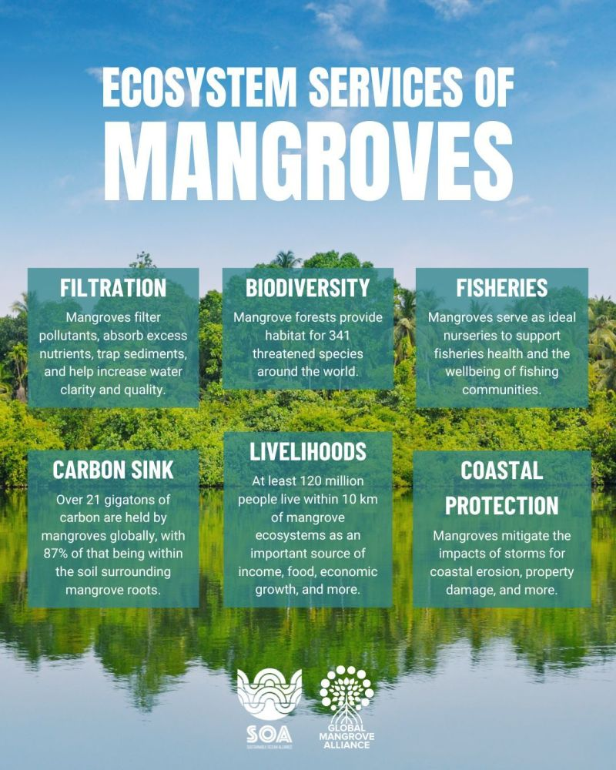

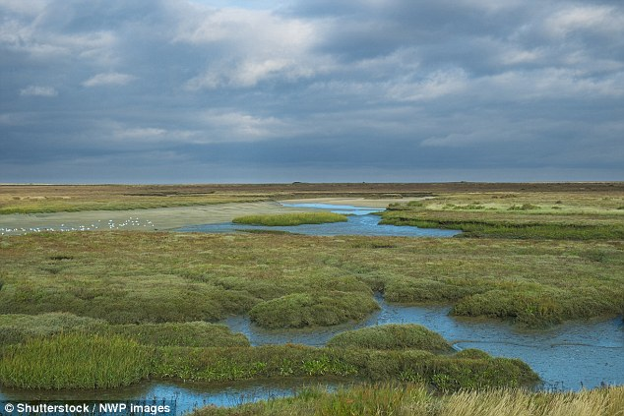
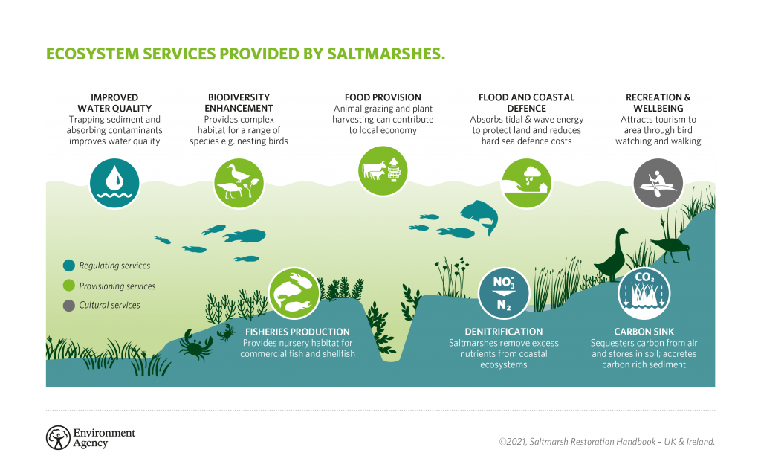
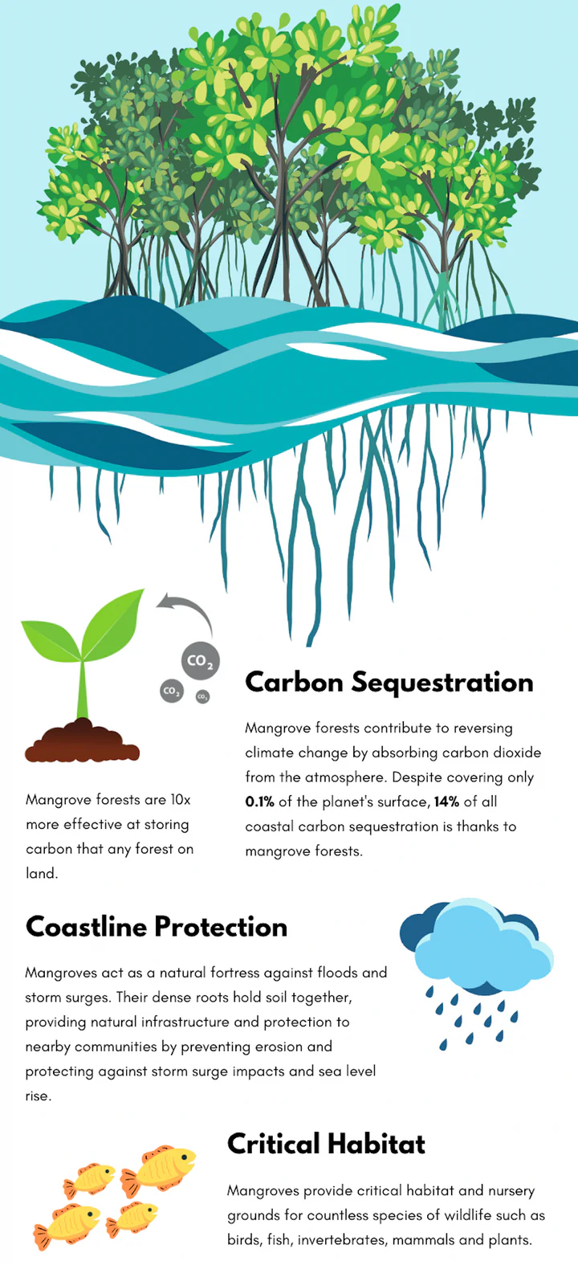
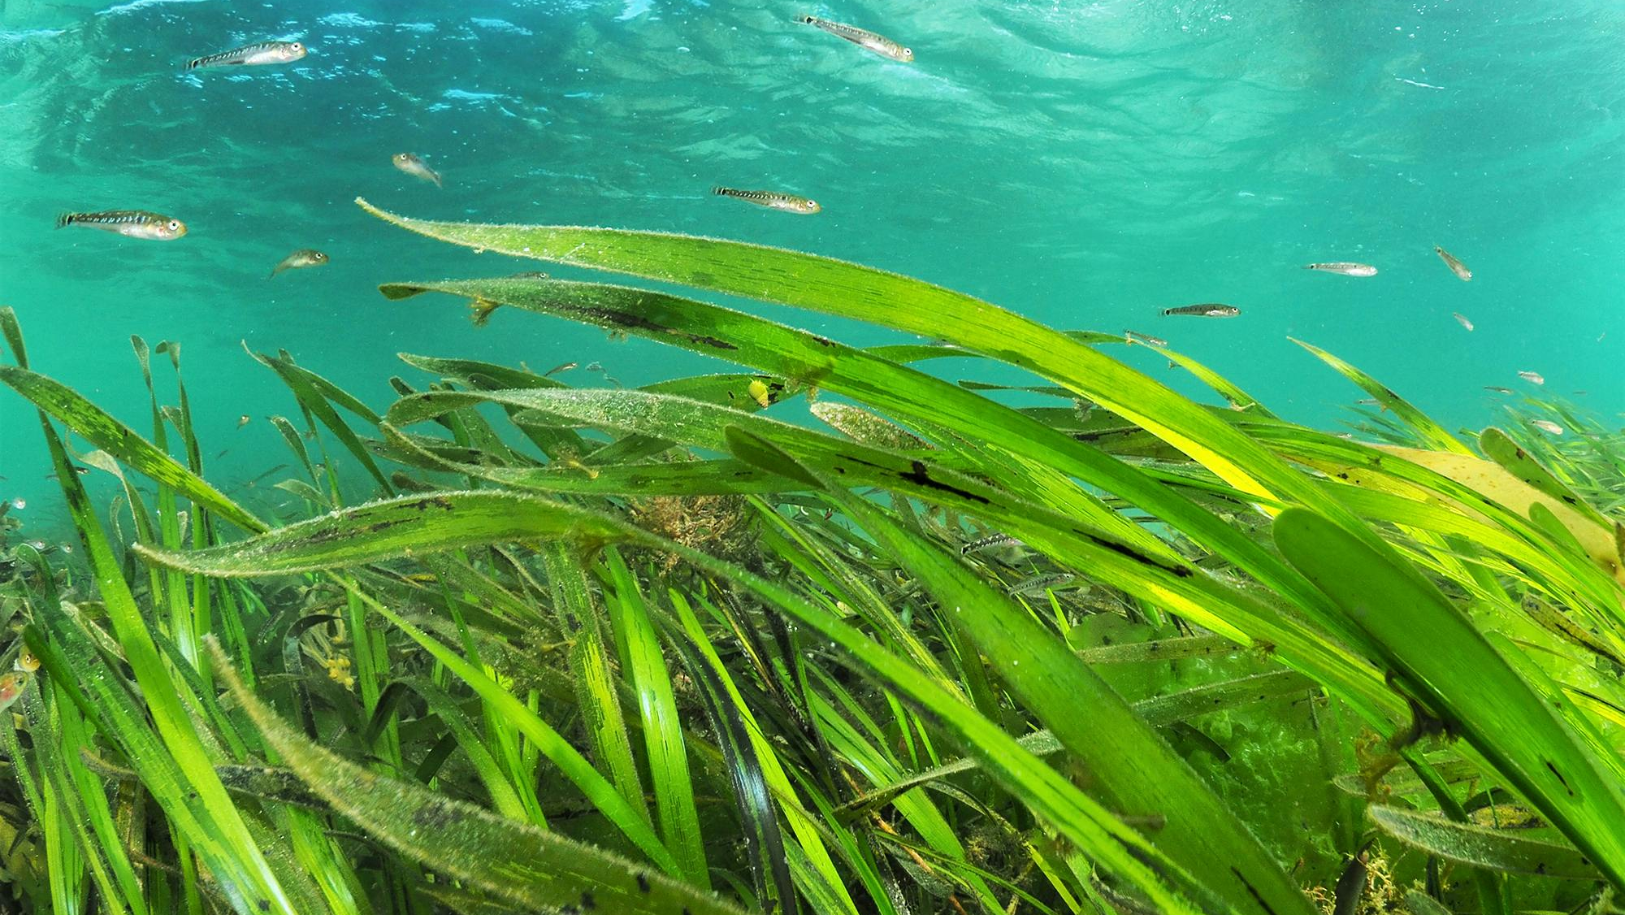
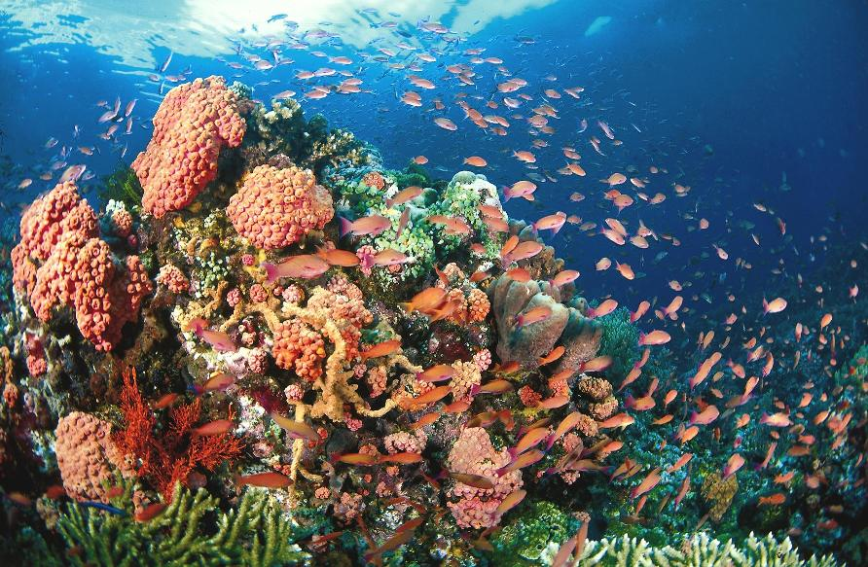
Ecosystem services of coastal ecosystems
Mangrove
Marsh
- 4,620 lives/yr
- $447 billion/yr
Seagrass
Carol
Notes:
Norfolk
https://www.dailymail.co.uk/sciencetech/article-5945475/Marshlands-UK-VANISH-2100-sea-level-rise.html

Slide 6
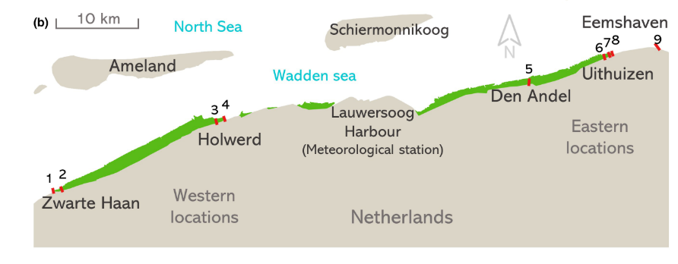
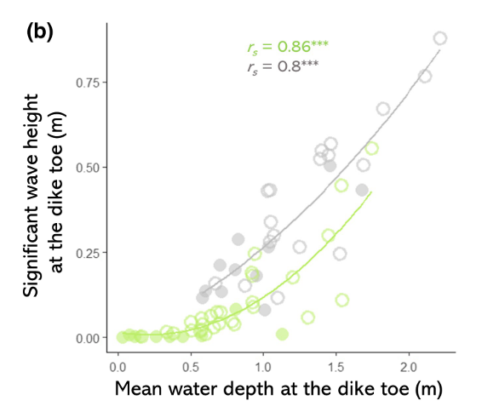
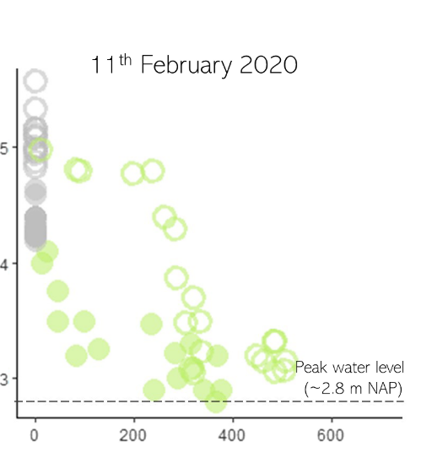
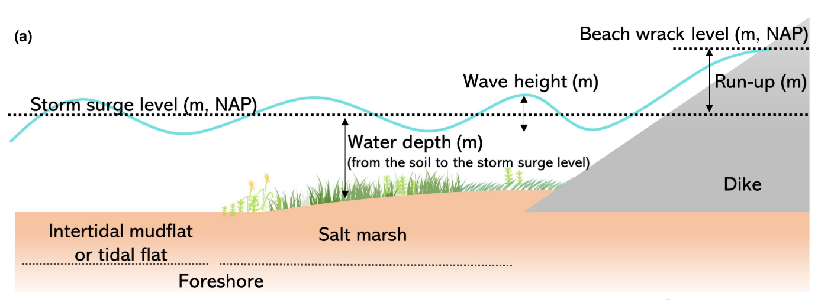
Moller 2002
Wave attenuation by salt marshes in the Netherlands
Study sites
Wave height at dike toe
Marsh
Mudflat
East
West
Beach wrack levels
Wave height (m)
Beach wrack levels (m)
Transect
Water depth at dike toe (m)
Marsh width (m)
Marin- Diaz et al. 2023
Notes:
15 yrs

Slide 7
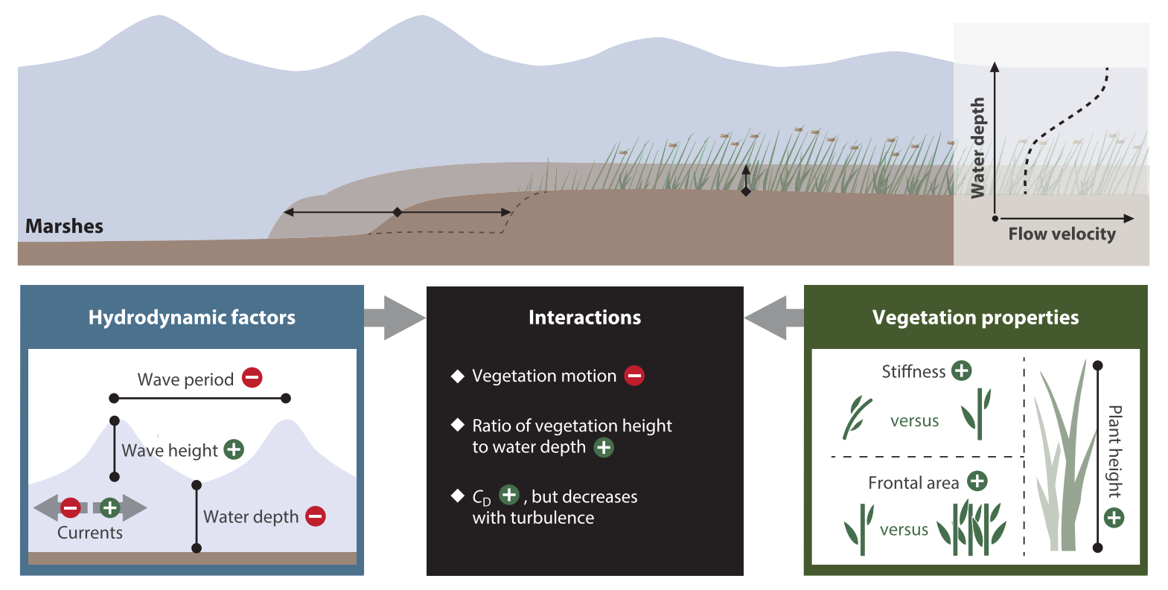
Main factors affecting rates of wind wave attenuation

Slide 8
Applications of ML
Improving parameterization
Surrogate models
Emulation (fast sensitivity analysis)

Slide 9
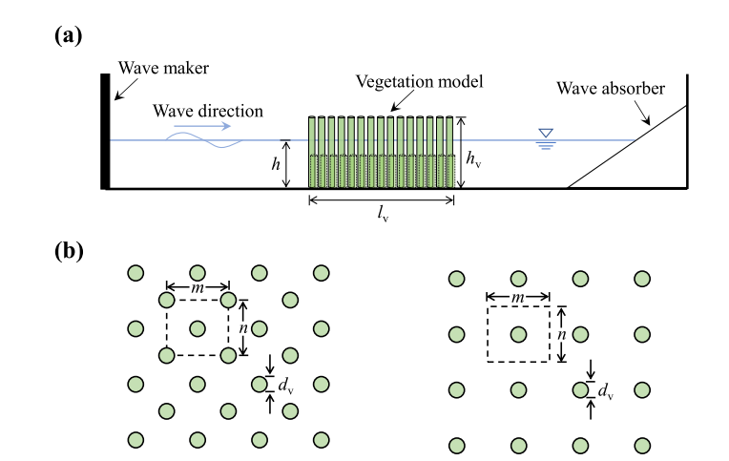
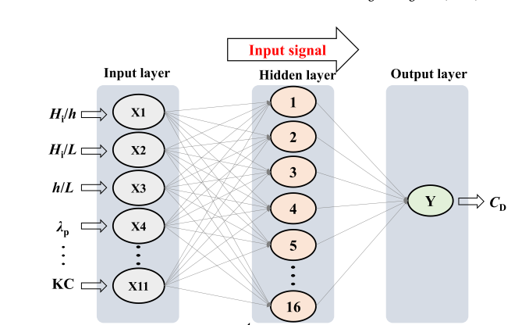
ANN for wave attenuation by rigid vegetation
Wang et al. 2023

Slide 10
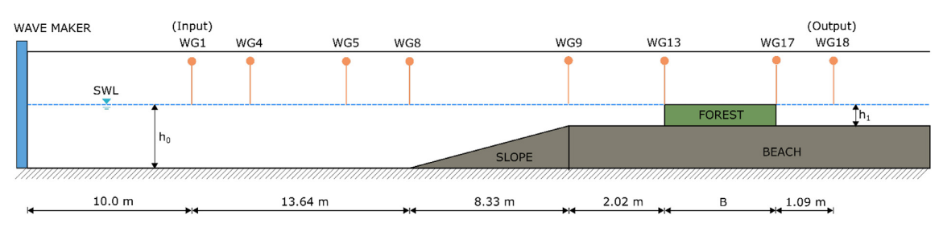
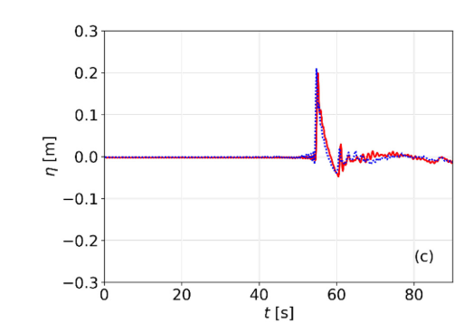
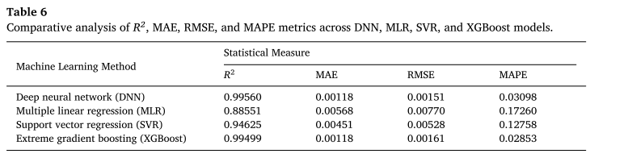
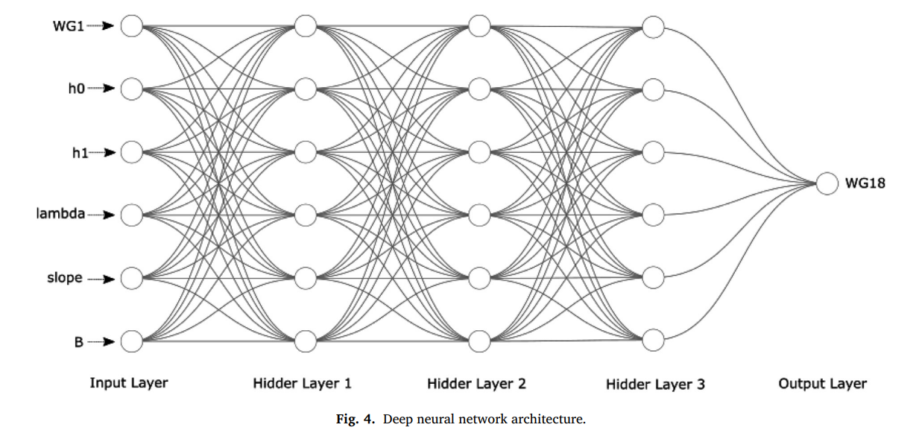
DNN for tsunami wave attenuation by mangroves
In wave and flow attenuation, Kim et al. (2022) demonstrated two applications of ML. Firstly, they predicted wave attenuation over an artificial reef using an artificial neural network (ANN) model trained on hydraulic experimental data, which yielded high accuracy. Secondly, they showed the power of ML models to perform sensitivity analysis on complex systems. Wang et al. (2023) also demonstrated the ability of ANNs to predict the drag coefficient for rigid vegetation. Wang et al. (2021) successfully implemented a genetic programming routine to derive a new predictor for the drag coefficient of flexible vegetation. Tinoco et al. (2015) used a genetic programming routine to derive a physically sound equation relating flow and vegetation characteristics to depth-averaged velocity over submerged rigid cylinders. However, the study highlighted the importance of experts in selecting the best numerical and physical solutions. Conversely, Maji et al. (2022) showed that the system could automatically learn without explicitly being programmed by using the polynomial regression ML method. This reveals a disadvantage of ML, with each ML application requiring individual assessment, and the most suitable approach must be selected based on the training data type and the target data. Several other studies have provided in-depth reviews of the application of ML techniques in coastal processes and modelling, highlighting the accuracy and performance advantages of ML over traditional empirical approaches (Chau, 2006; Hsieh, 2009; Valentine and Kalnins, 2016; Dwarakish and Nithyapriya, 2016; Goldstein et al., 2019; Beuzen et al., 2019). I
Experiment set up
Variational Boussinesq Model
Deep neural networks
40,000 data points
(70/30)
(Adytia et al. 2024)
(Kim et al. 2022)
When comparing the DNN model with three alternative machine learning models— support vector regression (SVR), multiple linear regression (MLR), and extreme gradient boosting (XGBoost)— the performance of DNN is superior to that of SVR and MLR, but it is similar to XGBoost.
Notes:
support vector regression (SVR), multiple linear regression (MLR), and extreme gradient boosting (XGBoost)
The use of DNN as a regression model has certain drawbacks. Firstly, the DNN model requires high data volume for accurate
regression. Secondly, due to the complexity of hyperparameter optimization in DNN models, only a few parameters can be optimized. In addition, DNNs involve computationally expensive processes, particularly when applied to large datasets and complex architectures. Future studies in wave attenuation prediction using DNN models should focus on devising algorithms to enhance the efficiency of the training process and investigating the integration of DNN algorithms with gradient boosting methods.

Slide 11
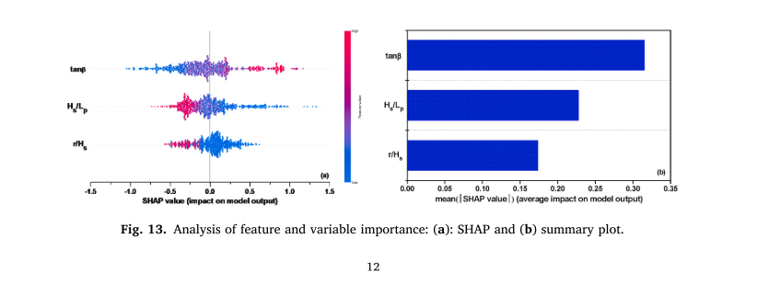
RF, SVM, and XGB for beach wave runup (Kim et al. 2024) *SHAP

Slide 12
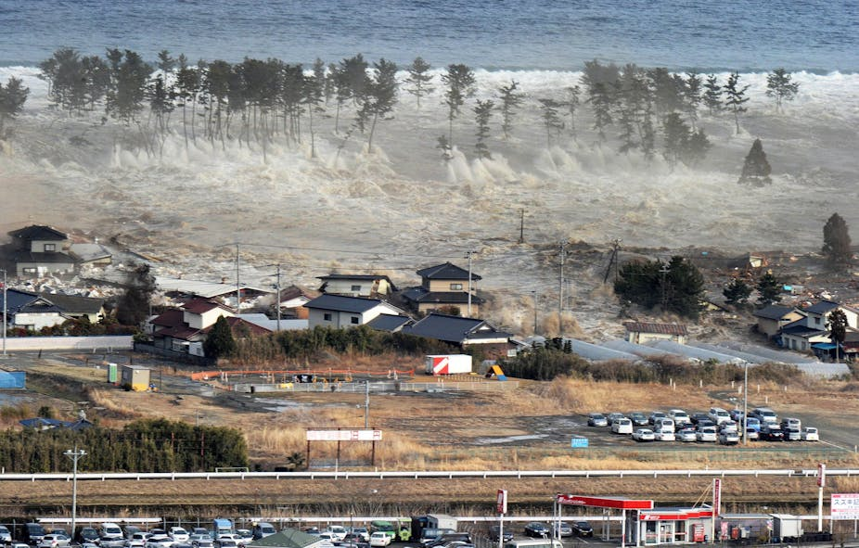
References & additional readings
Ions et al. 2024
ANN
Rigid vegetation
drag coefficient (Wang et al 2023)
GP
ANN for emergent vegetation extreme wave attenuation (Gong et al. 2021)
ANN for artificial coral reef wave attenuation (Kim et al. 2022)
Genetic programming & ANN emergent vegetation Tsunamis Transmission coefficient (Gong et al. 2021)
Notes:
https://theconversation.com/we-should-have-been-prepared-for-the-fukushima-tsunami-5735
Genetic Programming (GP),

Slide 13
Perfection = Effectiveness + Reliability
Definition: The effectiveness of marshes and mangroves as coastal storm buffers conceptually depends on
(a) their functionality, that is, their capacity to reduce storm surge levels, storm waves, and associated flood and erosion risks, and (b) their persistence, that is, their capacity to resist and recover from storm damage to the ecosystem and from other potential stress and disturbance factors, such as their ability to persist under long-term sea level rise through sediment accretion

Slide 14
Applications of ML
1 Ecosystem conditions influence effectiveness (recovery debt)
2 long-term stability
Ecosystem conditions
Over estimation Thuy et al. 2012
Recovery debt
Long-term stability

Slide 15
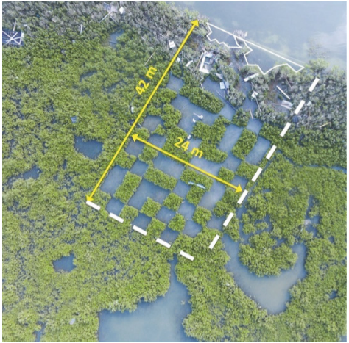
Erosion mitigation during hurricanes by mangroves in the USA
Data from erosion stakes indicated up to 26 cm of vertical and 970 cm of horizontal erosion over 70 months in the plot with 0% mangrove cover, but relatively little erosion in other plots.
PENNINGS et al 2021

Slide 16
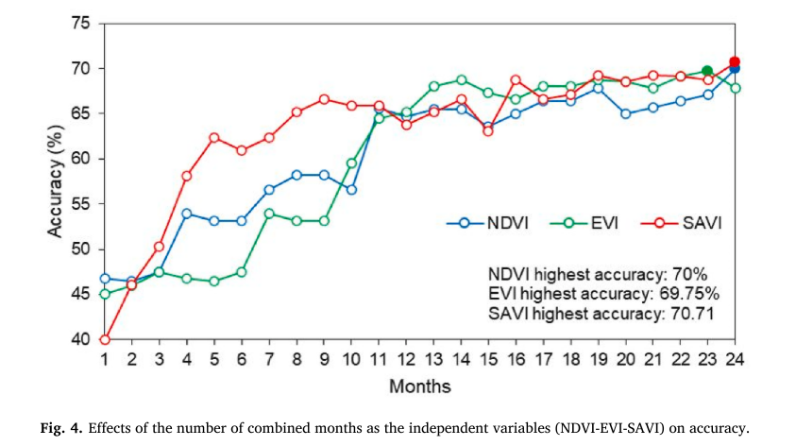
RF for mapping mangrove species in Indonesia
Aji 2023
With phenology

Slide 17
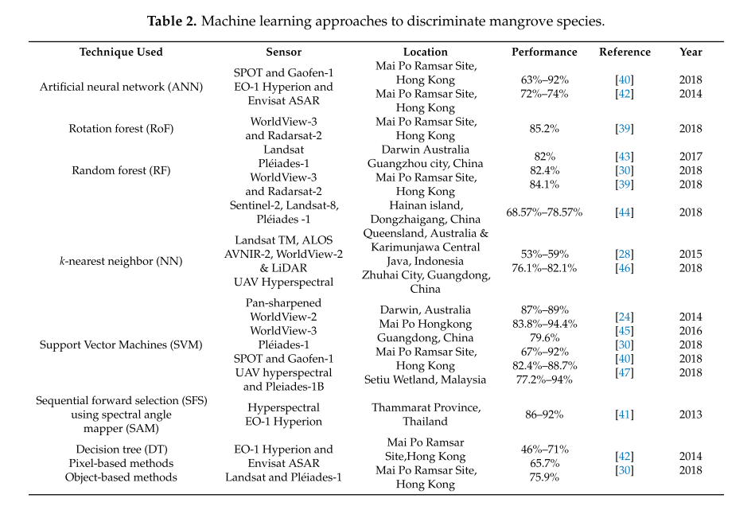
Mangrove species mapping with ML
Pham 2019
Notes:
Comme inputs?

Slide 18
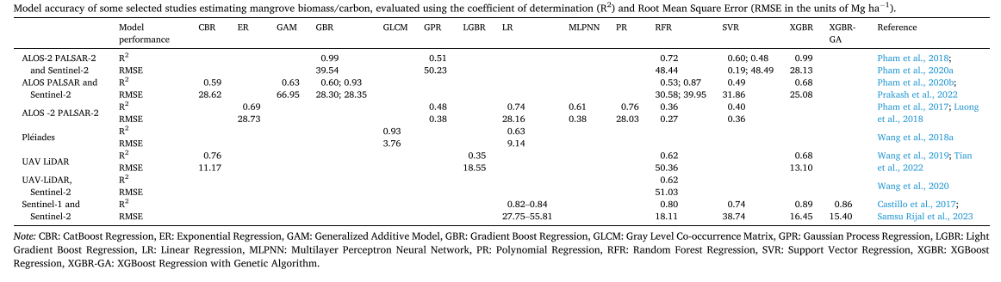
Blue carbon assessment with ML in the Asia-Pacific
Mangrove biomass & species mapping
Dutta et al. 2024 (review)

Slide 19
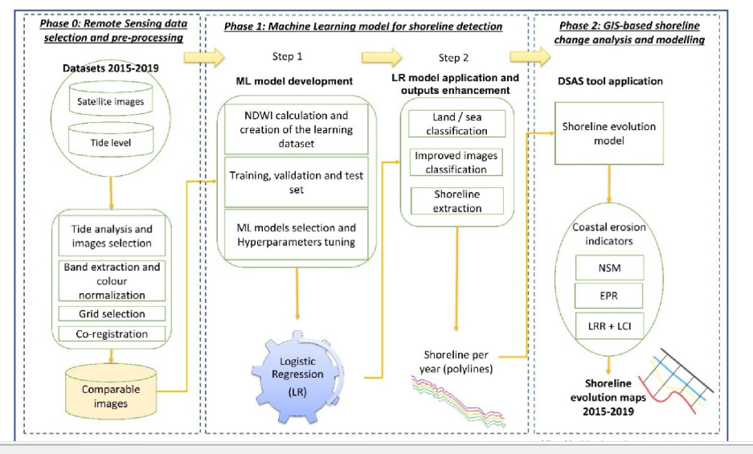
Evolution trend for marshes in Venice
Fogarin 2023

Slide 20
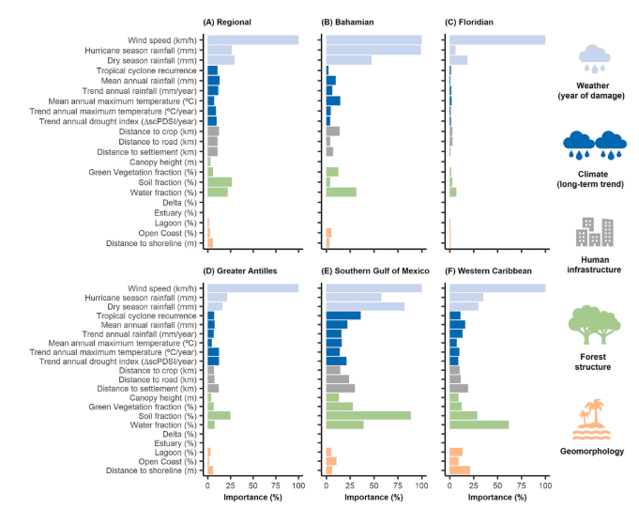
The resilience of North Atlantic mangroves to storms
Amaral 2023

Slide 21
Interoperability
A translucent box: interpretable machine learning in ecology TIM C. D. LUCAS
methods—Partial Dependence Plots (PDPs), Accumulated Local Effects (ALE), Permutation Feature Importance (PFI), and Local Interpretable Model-agnostic Explanations (LIME)
Sun 2024

Slide 22
Storm damage to global mangrove ecosystems
Yu

Slide 23
References & additional readings
A translucent box: interpretable machine learning in ecology TIM C. D. LUCAS

Slide 24
Coastal ecosystems for storm protection
Summary
Directions:
Challenge:
Effectiveness
Reliability

